Slide 1
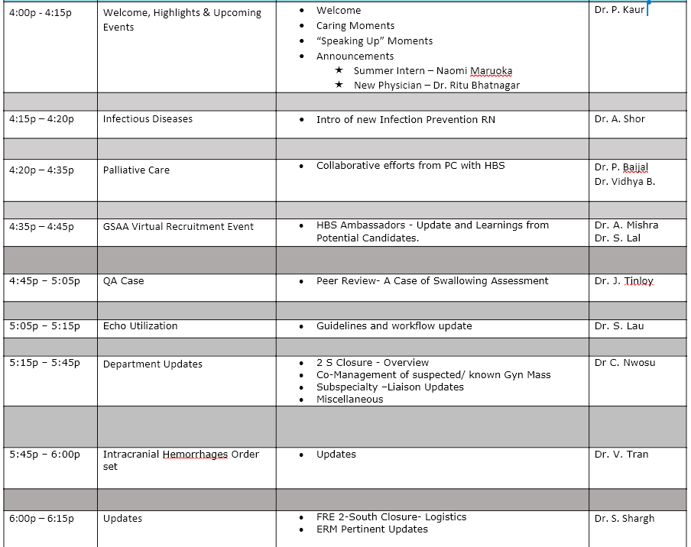
HBS Department Updates june 2022

Slide 2


Speaking Up & Caring Moments
Consider sending an ecard through Kaiser to someone who has been kind, compassionate, or innovative (to give a few examples):
https://caringmoments.kaiserpermanente.org/ecard/
https://caringmoments.kaiserpermanente.org/ecard/

Slide 3
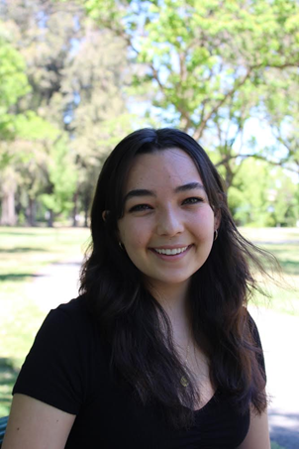
KP Launch Summer Intern – Naomi Maruoka
Naomi currently attends UC Davis and is majoring in International Relations with a minor in Public Health. She has worked as an Aggie Public Health Ambassador where she helped bring information to community members about COVID-19 resources and vaccinations.
Currently, Naomi lives in San Leandro and works as an EMT. She is interested in attending Nursing school and will be working towards completing her pre-requisites after graduating.
During her free time, she loves traveling, hiking, and gardening.
Please help in welcoming Naomi to our wonderful HBS department!

Slide 4
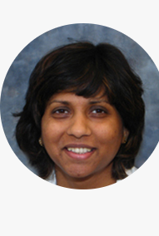
New hbs physician ritU bhatnagar, md

Slide 5
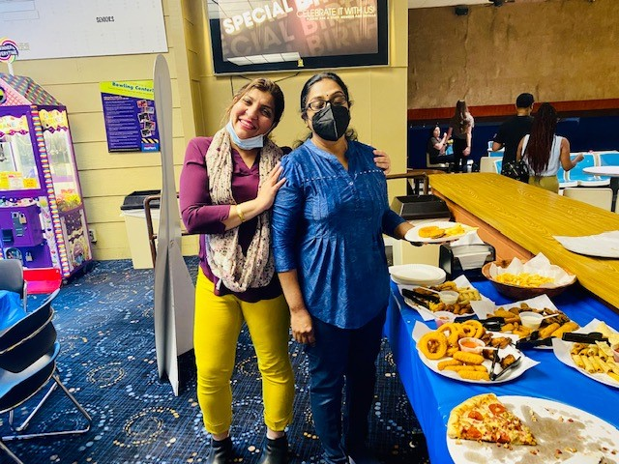
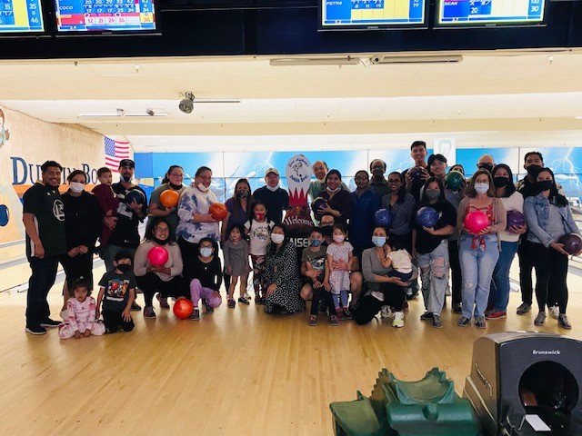
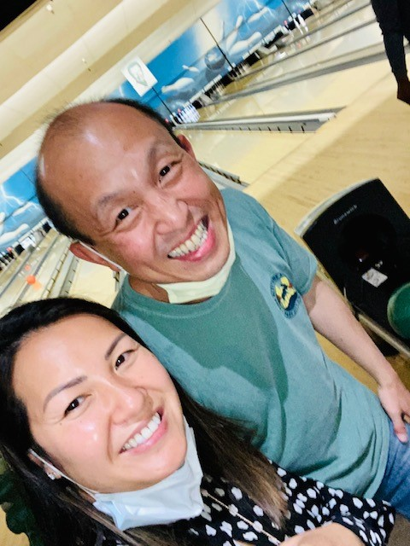
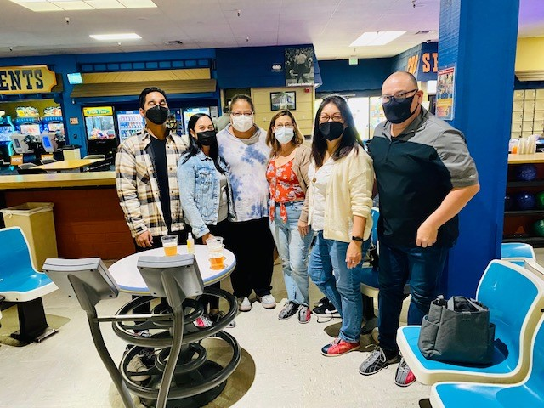
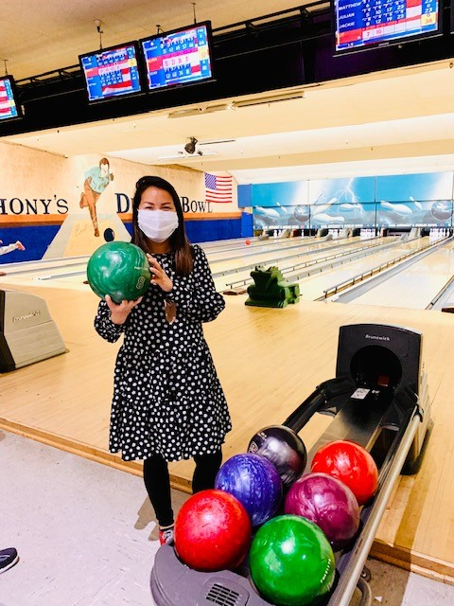
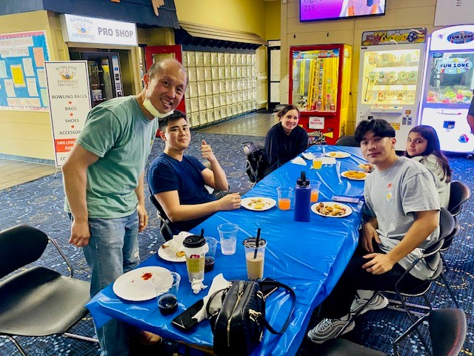
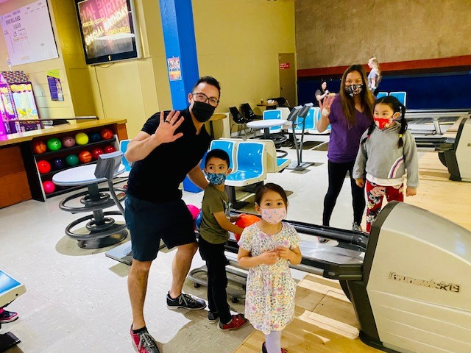
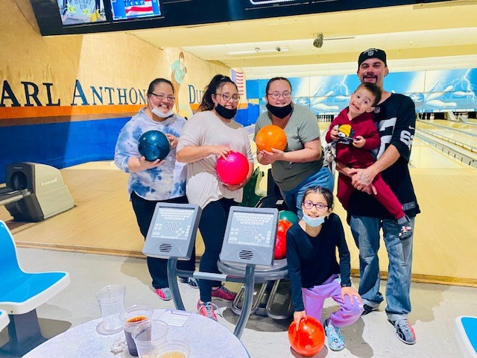
HBS Family bowling event june 2022

Slide 6

Celebrations

Slide 7

june Birthdays
Hadie Khodabakhsh 6/9
Jen Tinloy 6/9
Vijay Tiwari 6/18
Stephen Lau 6/18

Slide 8

Physician Recognition

Slide 9
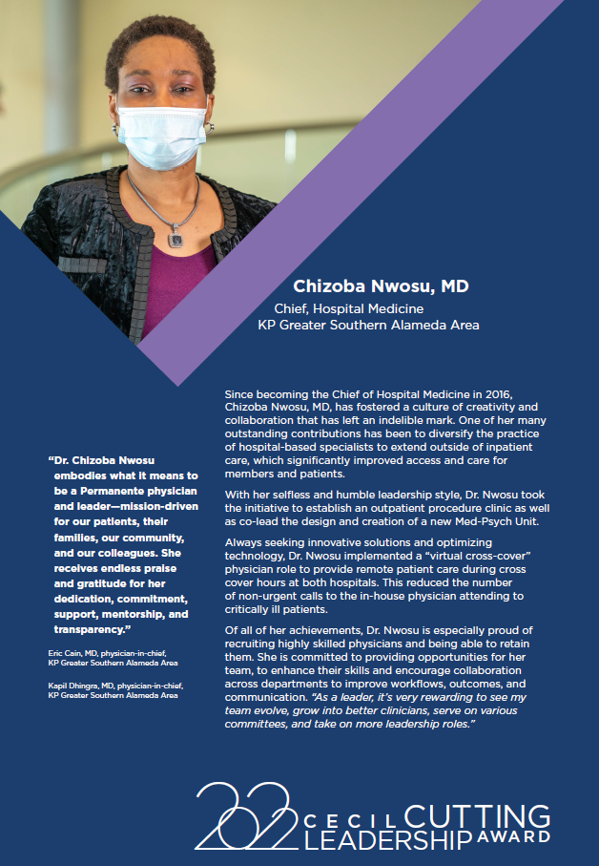
Chizoba Nwosu, MD – TPMG Awards (kaiserpermanente.org)

Slide 10
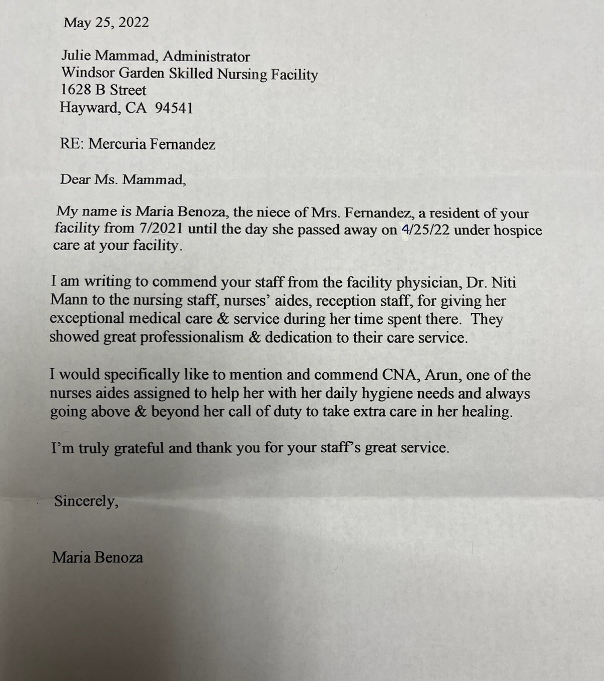
Thank you, dr. Mann!

Slide 11
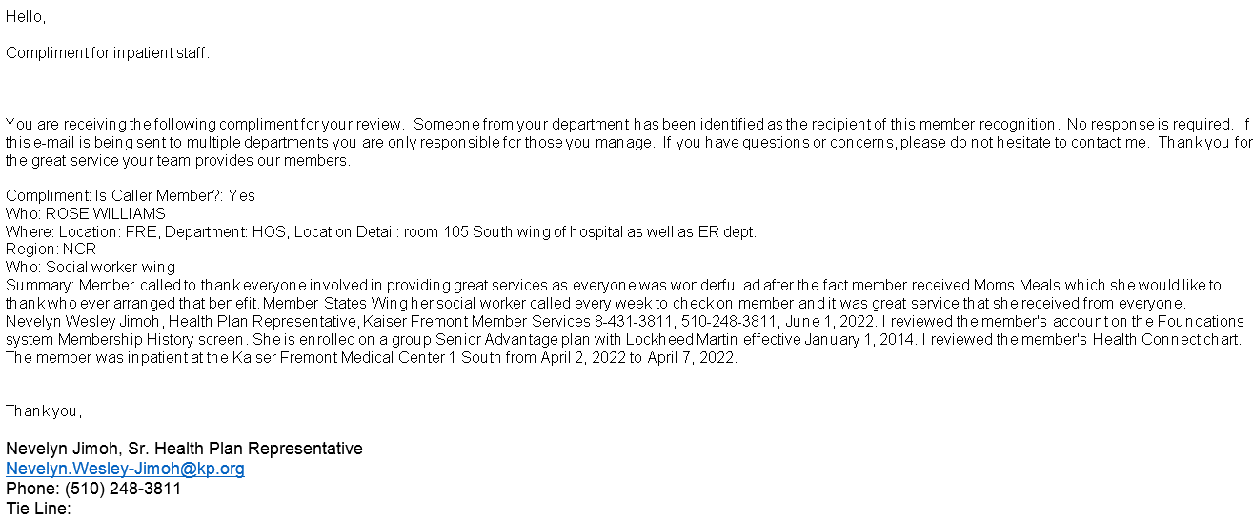
Thank you, Dr. Huynh!

Slide 12
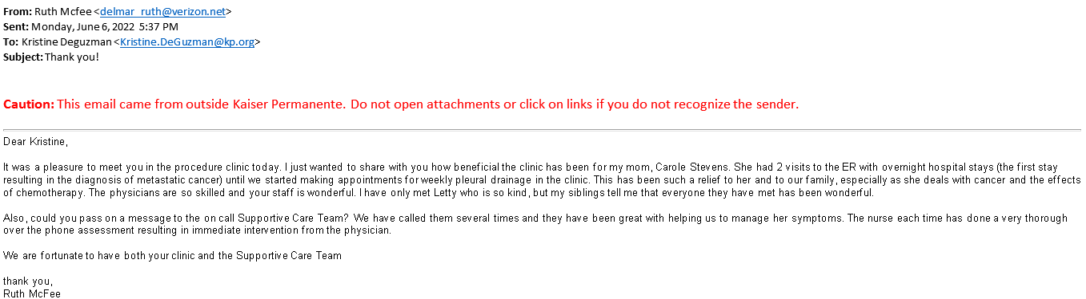
Amazing job well done, Procedure Team!

Slide 13
Infectious Diseases
Dr. Asaf Shor
INTRO OF NEW NP'S
UPDATES IN INFECTION CONTROL
Meeting Minutes:
Introduced new ID Prevention NPs – Robbie and Olivia
Availabilities: Mon – Fri business hours
Contact info will be sent out to the group
Review of basic infection control protocols
Isolation guidelines: MRSA and ESBL (90 days from last infection), VRE (6 months), CP-CRE and CRE (indefinitely)

Slide 14
Comfort care case series
Pooja Baijal MD
Chief, Supportive care services, GSAA
Meeting Minutes:
End of life discussions are associated with improved outcomes in patients, caregivers, less aggressive medical care near death and earlier hospice referrals
Goal is to have more Lunch and Learn comfort care series once every 3 months to discuss cases where pts were transitioned to comfort care and to identify learnings and opportunities for improvement
Addressing concerns about triaging consults, increasing staffing (including MDs and NPs). Please try to include some details in the comment section of consult request.
Workflow: Palliative care team will Cortext attending with recommendations and if agreed upon, PC MD/NP can place orders
Dotphrase “.goalsofcare” is regional dotphrase to document GOC conversations in any note type
Concerns from group:
- AAM alert triggers should be triaged and discussed with primary attending before seeing the pt
- Recommendations/orders to be placed by PC MD/NP to prevent delay in care
- PC should continue to follow particularly complex cases
- Concern that SW does not have enough medical background to carry out PC discussions

Slide 15
Introduction
Death at home is preferred by most people and those dying at home or in hospice facilities has increased over the last 2 decades.
Patients who die at home with hospice have fewer unmet physical, emotional needs & report a favorable dying experience than patients dying in institution.
End of life discussions are associated with improved outcomes in patients, caregivers , less aggressive medical care near death & earlier hospice referrals
Diagnosis of impending death can guide important medical decisions as well as inform personal decisions for family caregivers.

Slide 16
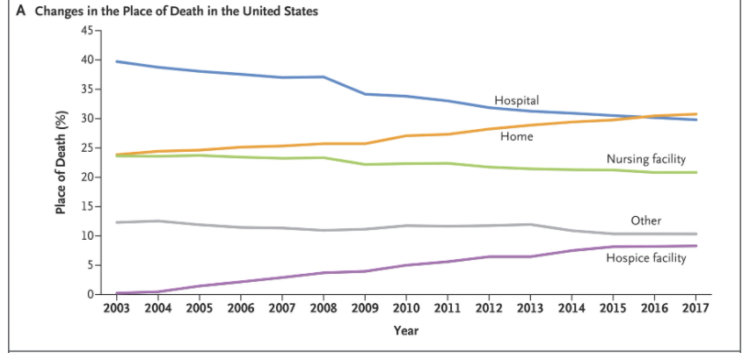
Background
December 12, 2019 N Engl J Med 2019; 381:2369-2370 DOI: 10.1056/NEJMc1911892
Notes:
A new analysis of death data published in NEJM found that dying at home surpassed dying in hospital in 2017 for the first time since the early 20th century, number of deaths at home increased from 23.8% in 2003 to 30.7% in 2017.The number of deaths in hospital decreased from 39.7% in 2003 to 29.8 % in 2017. These trends were seen across all diseases.

Slide 17
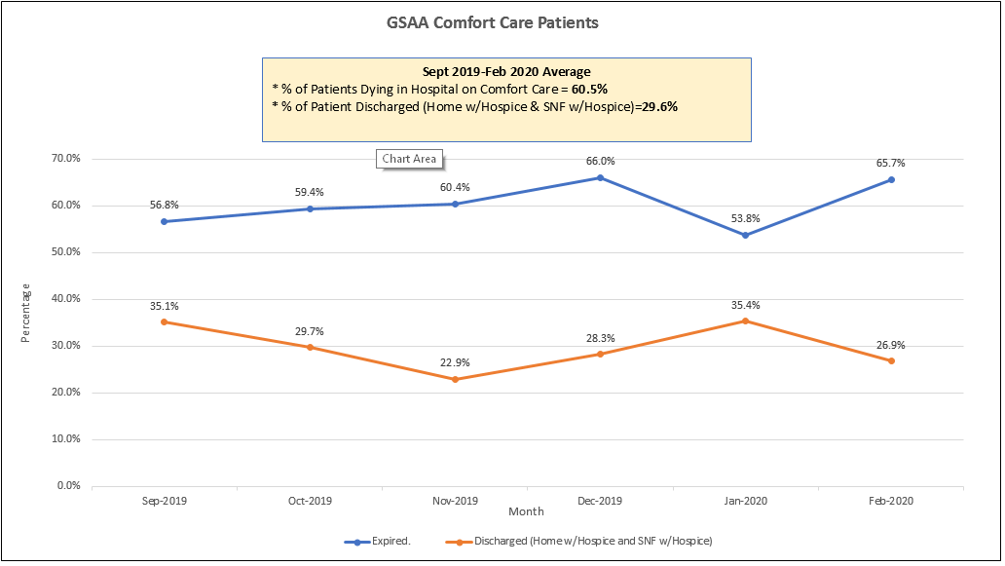
How are we doing at GSAA?
Notes:
10.4 % passed away after 72 hrs of placement of comfort care orders

Slide 18
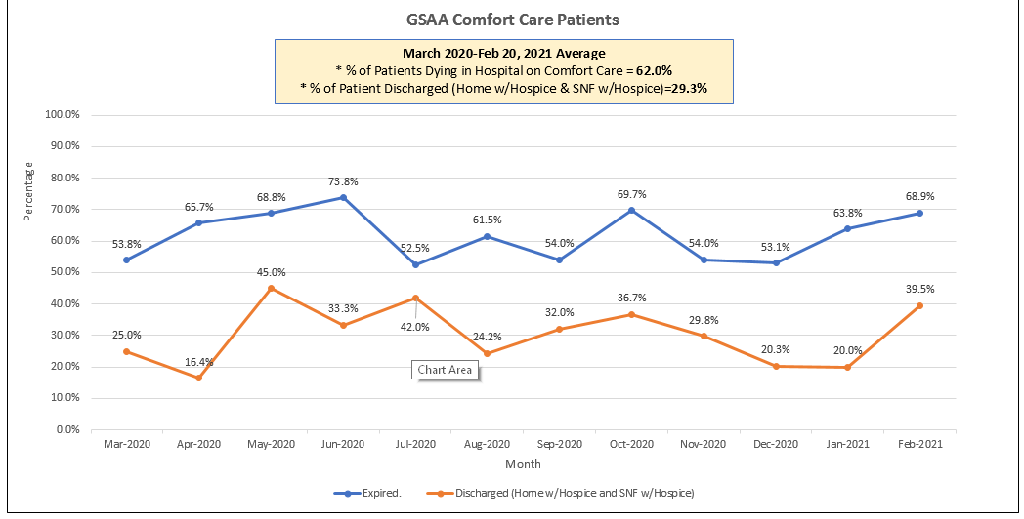
How are we doing ?
Notes:
8.5% of patients passed away after 72 hrs of time of initiation of comfort care order

Slide 19
Goal based on Hypothesis
Improve prognostication of imminent death & communication at end of life
Address financial barrier that prevents caregivers to provide care outside hospital setting

Slide 20
Intervention
2 Lunch & learn sessions for HBS -74% attendance , post session evaluation-83 % agreed to integrate in practice
Work group to identify financial resources & standardize the process to share with target population

Slide 21
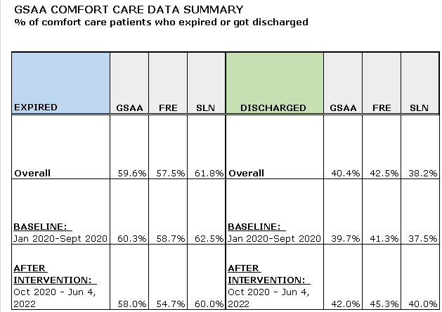

Slide 22
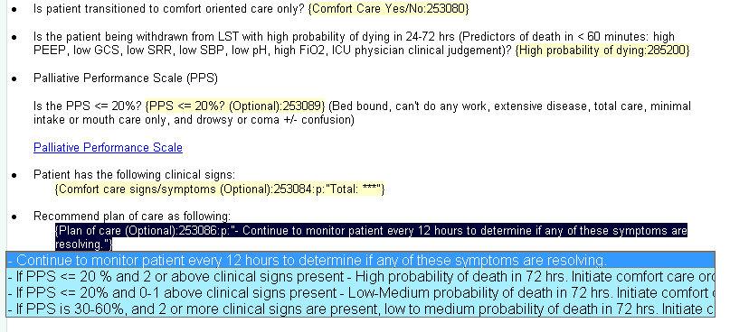
Prognostication tool to predict imminent death

Slide 23
Lunch & Learn Comfort care case series
Discuss cases who were transitioned to comfort care
Once every 3 months
Identify learnings and opportunities for improvement

Slide 24
HBS-PCT Liaison Updates
1) Triaging
--when staffing allows, we are prioritizing that new PC consults are done w/ MDT led by an advanced practitioner
--we are continuing to work on increasing staffing
--if able, provide additional clinical information in the consult request. Regardless, the workflow is for PCT to reach out to discuss before and after consult
--if clinically complex case, can specify ‘MD preferred’ in the consult text. Please use this sparingly
--in the setting of staffing limitations/weekends, consider teaming with PC ancillary staff to provide medical updates and prognosis
2) Orders
--workflow is for PC MD/NP to reach out with recommendations via cortext or telephone and IF agreed upon, MD/NP can place orders
3) Repeat Consults
--please review prior LCP notes which are accessible by either hovering over the LCP prompt in patient header, filtering notes by LCP, or by searching the Supportive care navigator
--please be amenable to discussion as to the best timing for PCT to be re-involved
Ongoing Discussions: Workflow for POLST completions, code status clarifications, continuity for comfort care patients, primary palliative care catalyst

Slide 25
.GOALSOFCARE is a Kaiser Permanente HealthConnect dotphrase designed for Physicians, Nurse Practitioners and Physician Assistants documenting goals of care conversations in any note type. This smartphrase ensures clinicians can easily find your documented goals of care conversation in the Supportive Care Navigator. This smartphrase has been streamlined based on extensive physician feedback and is going live with these enhancements in January 2022. The smartphrase includes multi-select drop down fields and free text for ease of documentation.
GOALS OF CARE DISCUSSION DOTPHRASE
Clinical Context | Multi-select and free text
Agents | Auto-populated from Demographics
GOC Discussed With | Multi-select and free text
Patient/Family Understanding of Illness | Single-select or free text
What Matters Most / Quality of Life | Multi-select and free text
POLST | Single select, and POLST template available
Plan | Multi-select and free text

Slide 26

Sample Note
GOALS OF CARE DISCUSSION
Clinical Context: Change in Clinical Condition, Critical Illness
GOC DISCUSSED With: Family: wife
Patient/Family Understanding of Illness: Informed
What Matters Most/Quality of Life: Avoid being in hospital, minimize suffering.
Summary of Discussion: Discussed current need for intubation after respiratory code and need to evaluate over next 24-48 hrs. Agreeable to no CPR but will otherwise continue full support for next 48 hrs and discuss then.
POLST na
Plan: Continue current treatment plan for next 48 hrs and discuss at that time. Partial code

Slide 27
HBS Department Meeting Updates
JUNE 2022

Slide 28

GSAA Recruitment Event
HBS Ambassadors:
Amit Mishra, MD
Sandeep Lal, MD
Meeting Minutes:
Consisting of about 120+ physicians from all over the country who are interested in joining GSAA
Gave information about our group and our accomplishments

Slide 29
QA case presentation/Peer Review
HBS Department Meeting 6/27/22
Meeting Minutes:
HPI: 70 yo male with CHF, COPD, CKD, presents in 12/2021 with cough/chest pain and found to be hypoxic. Found to have PE. Admitted to ICU for intubation. Complicated by hypotension, decomp CHF and ARDS. Pt extubated. Evaluated by ST multiple times and found to have overt signs of aspiration. ST recommend HNS consult to evaluate vocal cords for aphonia. HNS unable to perform complete exam due to NGT and recommend PEG tube in order to do repeat exam. HNS noted improved hoarseness but still with poor clearance and recommend to continue with ST. HBS noted improvement in alertness and ordered bedside swallow screen. Pt passed bedside swallow and was ordered for pureed diet. Pt noted to tolerate 25% of lunch. Pt later became more hypoxic and hypotensive then code blue was called. Pt achieved ROSC but coded again and passed away. CXR shows bilateral opacities – edema vs. infection. Per HBS provider, pt was alert and oriented and expressed wanting to eat/drink. Spoke to ST but they were not sure if able to see pt that day, therefore, decision was made to do bedside swallow evaluation.
Tee up Questions:
Was the pt an appropriate candidate for bedside swallow screen?
Were orders for oral feeding appropriate following completion of bedside swallow screen?
Presented by Jen Tinloy
HBS QA liaison

Slide 30
QA referral
Alleged inappropriate oral feeding in a patient with high risk for aspirations and recommendations by Speech and HNS for NPO.

Slide 31
HPI
70 yom w/hx of systolic CHF (EF 30-35%), COPD, CKD, and tobacco use who recently tested positive for COVID and was brought into the ED on 12/29/21 for cough and bilateral chest pain and was found to be hypoxic.
CT angiogram of the chest revealed a PE and the patient was admitted to the ICU after requiring intubation due to persistent hypoxemia.

Slide 32
Hospital Course
ICU course complicated by hypotension, decompensated CHF, and ARDS.
Pt was extubated on 1/9/22 for about 1.5 hours but was re-intubated due to respiratory distress.
1/12/22, patient successfully extubated.

Slide 33
ST evaluations
14 Jan. 22
ST eval with signs of post-extubation dysphagia with recommendation for NPO.
16 Jan. 22
ST eval with continued overt signs and symptoms of pharyngeal phase dysphagia with recommendation to remain NPO and consider FEES.
17 Jan. 22
The patient was transferred out of the ICU.
18 Jan. 22
FEES study was attempted but patient was unable to tolerate the study. The patient continued to demonstrate overt and subtle aspiration and aphonia.
20 Jan. 22
ST continued to recommended NPO for overt aspiration with PO trials and recommended HNS consult to evaluate vocal cords given persistent severe dysphonia and aphonia.

Slide 34
HNS evaluation
HNS evaluated on 1/21/22 with limited exam with scope due to NGT presence and secretions with ineffective cough and swallow with recommendation to repeat scope when patient is better able to participate. Additionally, consideration for PEG tube as removal of NGT would improve speech and swallow therapy.
1/22, ST discussed the case with HNS with a plan to continue NPO and ST to follow up the following week with instrumental swallow evaluation.
On 1/24, ENT reevaluated with scope w/findings of improved visualization of larynx and pooling of secretions in piriformis and poor clearance with swallow or cough.
  ENT assessment: improved hoarseness and ongoing dysphagia with recommendation to continue to work with ST as patient may be able to better participate with FEES evaluation.

Slide 35
Hospital Course (1/24/22)
HBS provider evaluated the patient and assessed that the patient was alert and conversant and ordered a bedside swallow evaluation by RN @930a. IVFs also ordered for tachycardia.
Per HBS note, patient passed a bedside swallow evaluation
The patient was started on a pureed diet @1230pm and NGT dc’ed. Patient ate 25% lunch with no documentation of aspiration or coughing. Per RN, well tolerated.
IVFs were stopped @140pm in the day when O2 requirement increased to 6L (from 2-3L).
Code blue was called for intubation/airway protection and then patient had asystole. Patient had several codes and achieved ROSC twice. Per family, if patient coded again, then no further intervention. Patient then pronounced at 7pm.
@ 6pm RRT was called for hypotension. The patient was started on pressors and IVFs.

Slide 36
CXR findings
1/24/22 6:30pm: Bilateral perihilar/basilar airspace opacities. Pulm edema vs infection.

Slide 37
Provider comments
Patient was last seen on 1/22/22 by ST with no follow up documented.
HNS recommended oral hygiene but nothing around continued NPO.
On 1/24, the patient was alert and oriented, wanting to eat/drink. Provider spoke with ST and they were not sure that they would be able to the see the patient that day due to staffing issues.
In order to go along with the patient’s wishes to eat/drink, a bedside RN swallow screen was ordered, and patient passed. Patient was duly tolerating diet.
Unclear if patient aspirated on food or his own secretions.
Patient had severe ischemic cardiomyopathy with decompensated heart failure and poor prognosis, which could have led to demise.

Slide 38
Tee-up Questions
Was the patient an appropriate candidate for a bedside swallow screen on 1/24/22?
Were orders for oral feeding appropriate on 1/24/22 following the completion of the bedside swallow screen? Please comment on whether adequate consideration was given for the risk of aspiration.

Slide 39
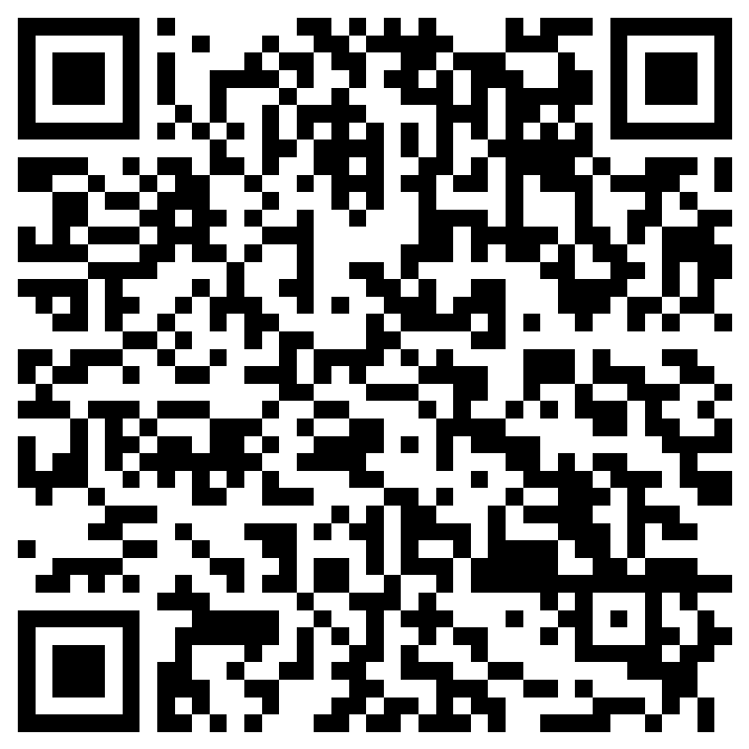
Scoring
https://forms.office.com/Pages/ResponsePage.aspx?id=xHuKPzfjpUeg_A1RLA4F8fokYr5P9EBNr4R-wCIog9VUMEVEQUdVOFY1UEsyMEJMVE1aSzhTR0xSOS4u

Slide 40
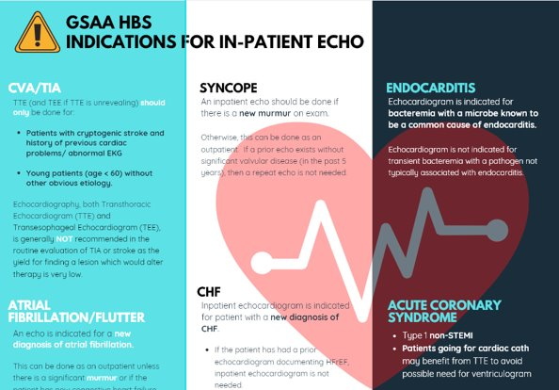
Echocardiogram Utilization
TTE Ordered
Cardiologist triages; priority based on acuity and discharge plans
(SLN: ~7 TTE/day)
Cardiologist may call HBS for those TTEs deemed not indicated, discuss if appropriate
Added:
Pericardial Effusion (suspected new effusion or suspected effusion with hemodynamic changes)
Acute PE (only if hemodynamic changes or if thrombolytics being considered)
Meeting Minutes:
Cardiologists have noticed improvement in appropriate ordering of TTE
Select the indication(s) listed under each diagnosis
Added indications
- Pericardial effusion (suspected new effusion or suspected effusion with hemodynamic changes)
- Acute PE (only if hemodynamic changes or if thrombolytics being considered)

Slide 41

HBS dept Meeting Update
June 27th, 2022
(Meeting minutes on next slide)

Slide 42
Meeting minutes
Fremont 2S closure: 9/14/22 – 10/20/22
Impacts 22 beds
Pre-closure 9/1 – 9/13 → moving pts to other units, SLN
All team members will need to have clear communication with pts that they will be moved to another hospital due to bed shortages
Close loop communication between Physicians, PCC and Transfer coordinator (PCC is NOT transfer coordinator)
Drs. Shargh and Kaur will go over elements of documentation (transferring/accepting MDs) and any changes to role of accepting physician in SLN in our next dept meeting in Aug
There will be no EPRP transfers during this time
Concerns from the group:
- Upstaffing ancillary services in FRE
- Expediting inpatient MRIs
- ED becoming too full to provide appropriate treatment
- ED calling for consults prematurely without appropriate work up
- Since no beds in FRE and cannot house pts in ED, does this qualify for code purple for community ambulances?
Subspecialty Update
More to come for various departments
7/19 (8:30 – 12:30pm) – Group Excellence Meeting
Evaluation and management of suspected Gyn malignancy:
Transfer to Oak Gyn if immediate surgery is needed
Gyn/HBS determine if primary complaint is related to mass (bleeding, infected mass, pain, etc)
- If yes, primary admission by local gyn and will consult HBS for co-management of medical problems
- If no (mass is incidental finding), then HBS will admit and gyn can be consulted for follow up recc
Questions/concerns:
- Does it matter if this is new or known malignancy?
- Gyn to be able to give input for imaging studies done without contrast
October Schedule:
GSAA support teams 1 and 2: Support 7 rounding teams in Fremont and workflow across both facilities during 2S closure
About 10 physicians requested for time off for board certification in hospice and IM. Each physician has been granted roughly about a week. Encourage to begin studying ahead of time. May bill for EL outside this one week period.
TPIP will be completed this year + year end incentive. Focus will be on technology and interdepartmental collaboration/group excellence along with specialty specific component. More updates will be provided as they become available. Will be primarily virtual.
Please be mindful not to ask new hires who have not started work for exchange of shifts.

Slide 43
Fremont :2S Closure
o Closure date: Sept 14-Oct 20
O Impact: 22 beds

Slide 44
Overview
Close collaboration and team collegiality is key to success
Fremont ED is a small capacity ED with only 20 beds available, typically houses a good number of patients on psychiatric hold. It’s very important that we lean in to support workflows that enhance flow of patients thru’ and thru’.
Clear communication to Patients/ families regarding need for transfer: NOTE : It’s not a dialogue because there are simply no BEDS to accommodate them in Fremont and they cannot be housed in the ED while waiting for a bed for XX hours. This should happen at the time of first encounter.(Same expectation for all other staff)
Close loop communication between Physicians, PCC and Transfer Coordinator. (PCC IS NOT the Transfer Coordinator)

Slide 45
Expectation and Brief Overview of work flow
Pre-closure- Ramp down of census will begin 9/1-9/13
Robust nonmember transfer primarily by ED to outside hospitals.
Early consults for patients clearly requiring admission with a presumptive diagnosis will be called . ED MD will continue to follow up on any pending results and will relay those to HBS / act on them accordingly. EDMD will complete all EMTALA transfer paperwork
All newly admitted patients should be considered for transfer to primarily SLN +/- KP and Non KP depending on bed availability.
  Transfers can happen at all hours.
  Exceptions: SNF placement, ICU patients, Services unavailable in the new location.
  Patients who are deemed unstable for transfer requires an MD documentation on the patient’s clinical status and what criteria needs to be met. This should be clearly communicated to the Transfer coordinator or ED Charge Nurse. HBS is expected to re-evaluate the patient within their shift time or sign out to incoming provider for follow up. *** Consider using TEAM COMMUNICATION w Time Stamp NOT the HBS Sign out list (Reserved for Virtual CX).
BLS transportation is readily available 24/7 and patients requiring higher level of need such as cardiac monitoring can be accommodated. May require an ED-RN to ride with the ambulance. This should not be a deterrent to transfer.
Cardiac Monitoring should be used for only patients who require it and/or meets the set guidelines.(please clearly indicate rationale for monitoring so it helps next physician who may be tasked with reviewing/potentially discontinuing the order).
Drs Shargh and Kaur will go over the elements of documentation (transferring/ accepting MDs) and any changes to the role of the accepting physician in SLN in our next meeting … August.

Slide 46
SUB-Specialty Update

Slide 48
Gyn Malignancy

Slide 49
Evaluation and Management of Known or Suspected Gyn Malignancy
ED>>Gyn consult
Gyn/HBS Determine if the primary complaint is related to Mass (Bleeding, Infected mass, Pain etc.)
Yes ,
Primary Admission by Local Gyn
Gyn>> Consult HBS for co-management of medical problems .
Gyn>>Consult Palliative Care if needed
No,
Mass is an incidental finding on imaging such as UTI/Pneumonia with mass on imaging; HBS will be primary.
HBS>>Consult Gyn : Formal/ Curbside/E-consult
Transfer to Oak- Gyn if immediate surgery is needed

Slide 50
Miscellaneous
October Schedule:
  GSAA Support Teams 1 & 2 : Support 7 rounding teams in Fremont and Workflow across both facilities during 2S Closure.
  About 10 physicians requested for time off for Board Certification in Hospice and IM : Each physician has been granted roughly about a week . I will encourage folks to begin studying ahead of time . You may bill for EL outside the one-week period.
TPIP will be completed this year + Year end Incentive: Focus will be on Technology and Interdepartmental collaboration/ group Excellence along with specialty specific component: More updated will be provided as they become available. It will be primarily virtual.

Slide 51
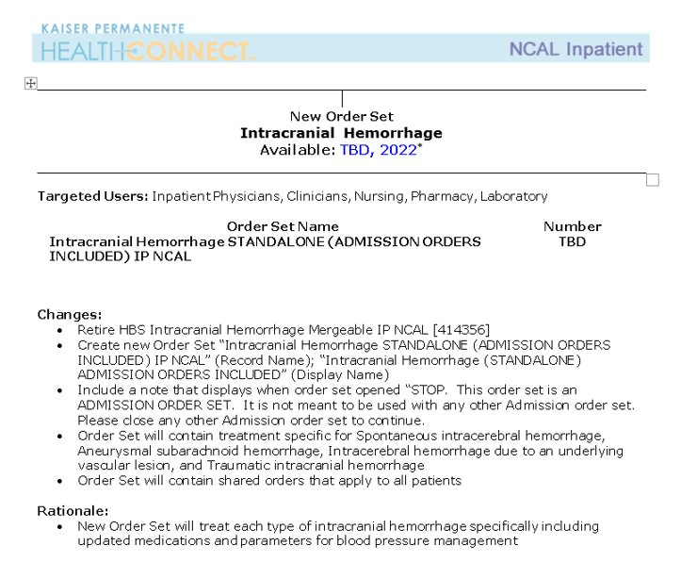
7/6/2022
Meeting Minutes:
Change in order set on 7/6/22
This will be a full orderset that includes HBS admission order set (no need to order separate order set for HBS admission)

Slide 52
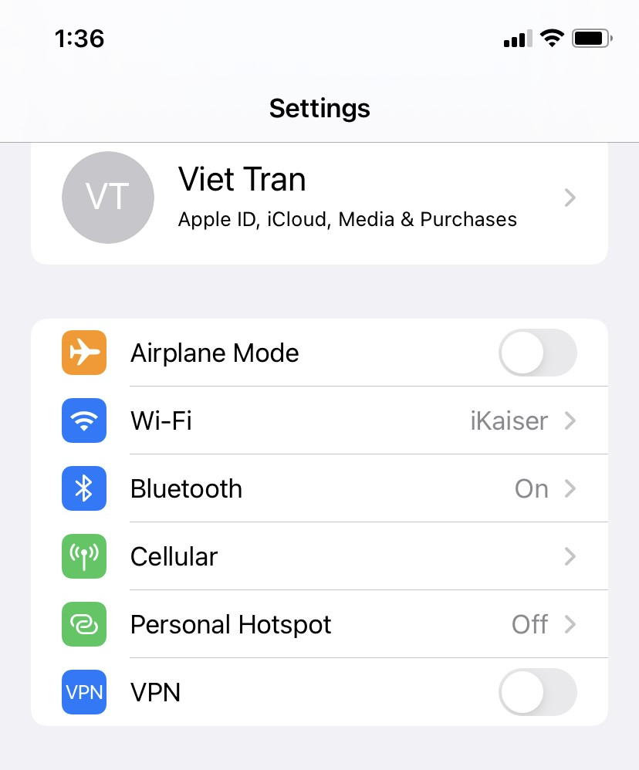
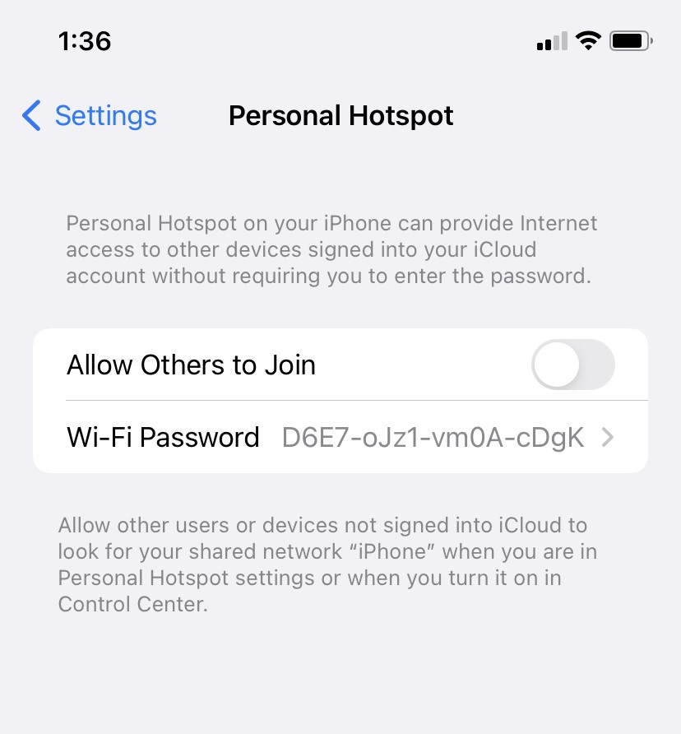

Slide 53
FRE 2-South Closure
Projected closure from September 14th through October 20th
  Ramp down period for 2 weeks: 9/1 – 9/13
2 South closure for renovations
  22 beds impacted
  PACU will serve some capacity as overflow for select # of beds
Anticipate shift changes to accommodate anticipated demands for patient transfers and patient census

Slide 54
Patient Interfacility Transfers
Developing set of criteria to increase the efficiency and frequency of patient transfers.
Especially pertinent with the upcoming Fremont 2-South closure
  Ramp down period prior to closure
  ED boarders during closure
Plan to finalize in time for August department meeting

Slide 55
ERM HBS Pertinent Updates
Reduce SCD use
  Chemical DVT PPx is preferred, unless contraindication
  Avoid SCDs in ambulatory patients
  Discontinue SCD order if transitioned to Chemic DVT PPx during hospital course
Sleep query
  Consider incorporating questions about patients’ sleep quality/quantity during rounds
  Key component of ERM, but also highlights focus on care experience

Slide 56

June 2022 Department Updates
Meeting Minutes:
ERM HBS pertinent updates
- Reduce SCD use → chemical DVT ppx is preferred unless contraindicated
- Avoid SCDs in ambulatory pts
- Discontinue SCD order if transitioned to chemical dvt ppx
Sleep query
- Consider incorporating questions about pt’s sleep quality/quantity during rounds
- Key component of ERM but also highlights focus on care experiences
Post hospital discharge appointments
- Please schedule 2-5 days post hospital not 1-3 days per AFM
- Use video visit format first
- Use own judgement if direct office visit is needed
Reminders
- Please remember to sign verbal orders
- Remember to check Dear Doctor notes for coding queries and address daily
- Senior Surgical Care: remember to complete for anyone expected to go for surgery
- Check daily for nursing end of shift report

Slide 57


Agenda
Post Discharge Appointments – 2- 5 days video visit strategy
CODING/VERBAL ORDERS
Senior Surgical Care
NURSING COMMUNICATION- END OF SHIFT REPORT/ERM COMPONENTS
Med Recon/Communication- KPACC med list
Care Experience

Slide 58

Post Hospital Discharge appointment
Please schedule 2-5 days post hospital not 1-3 per AFM
Video Visit strategy first
Use your judgement if you think Direct Office Visit needed instead

Slide 59
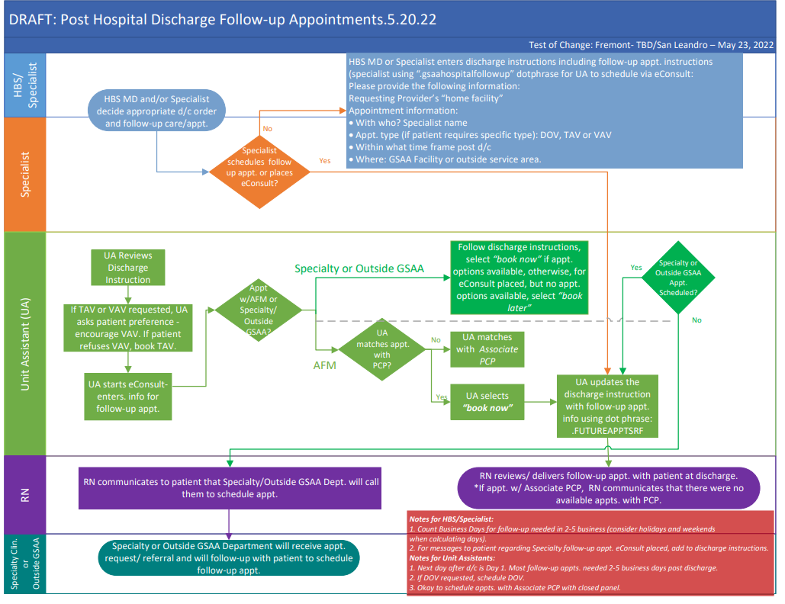

Slide 60
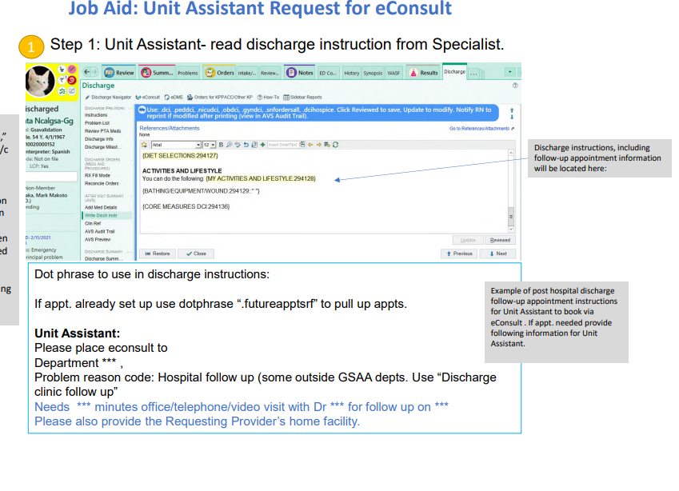

Slide 61
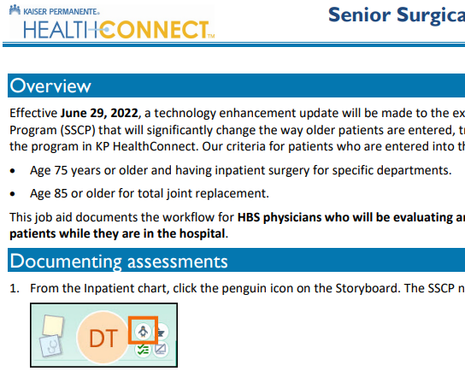
Reminders
Please remember to sign your verbal orders daily
Remember to check your dear doctor notes for coding queries and address daily
Senior Surgical Care- remember to complete for anyone expected to go for surgery

Slide 62
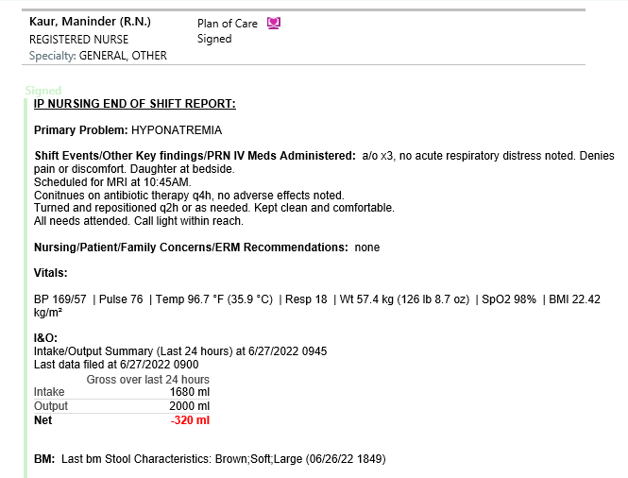
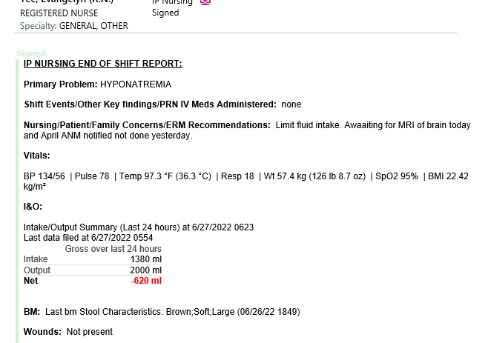
Nursing End of Shift Report- Remember to check daily

Slide 63
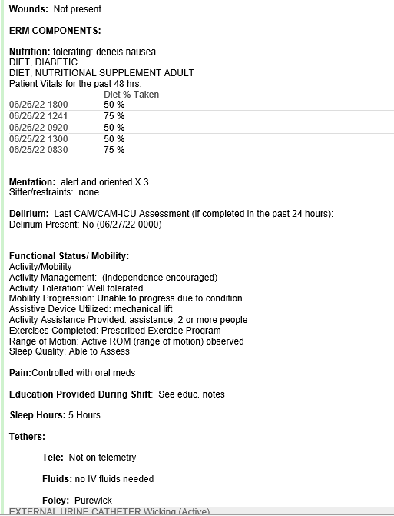
ERM DOCUMENTATION
End of shift Report

Slide 64
KPAC Med Recon- med list
Demo

Slide 65
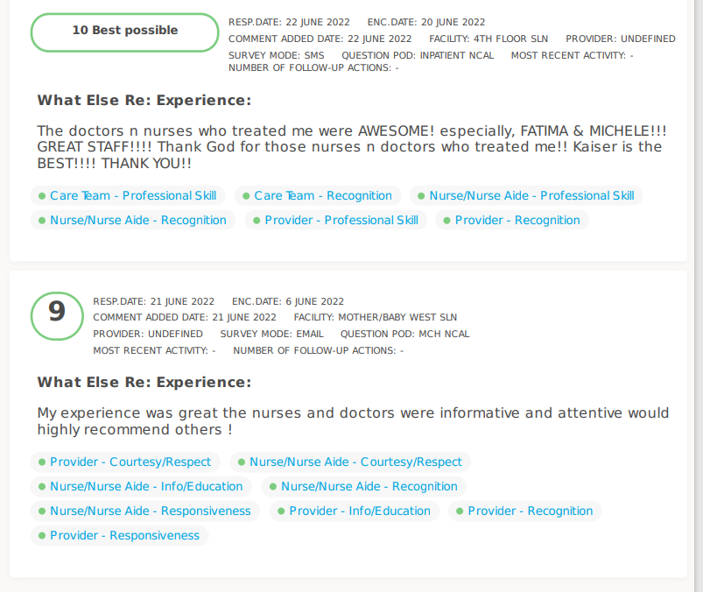
Care
Experience

Slide 66
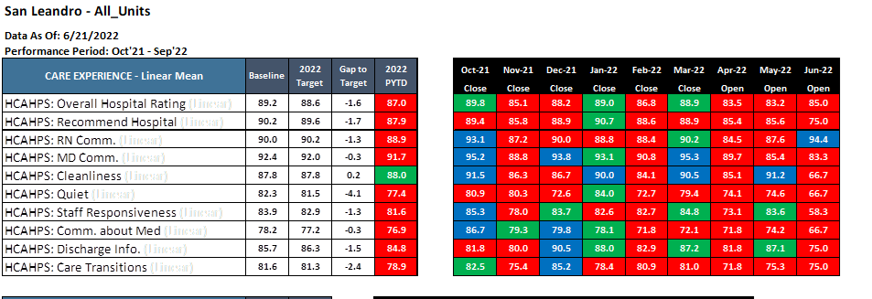
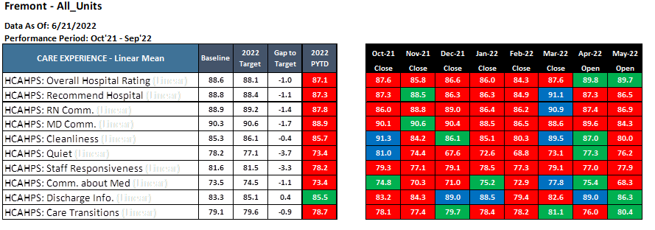
Care Experience

Slide 67
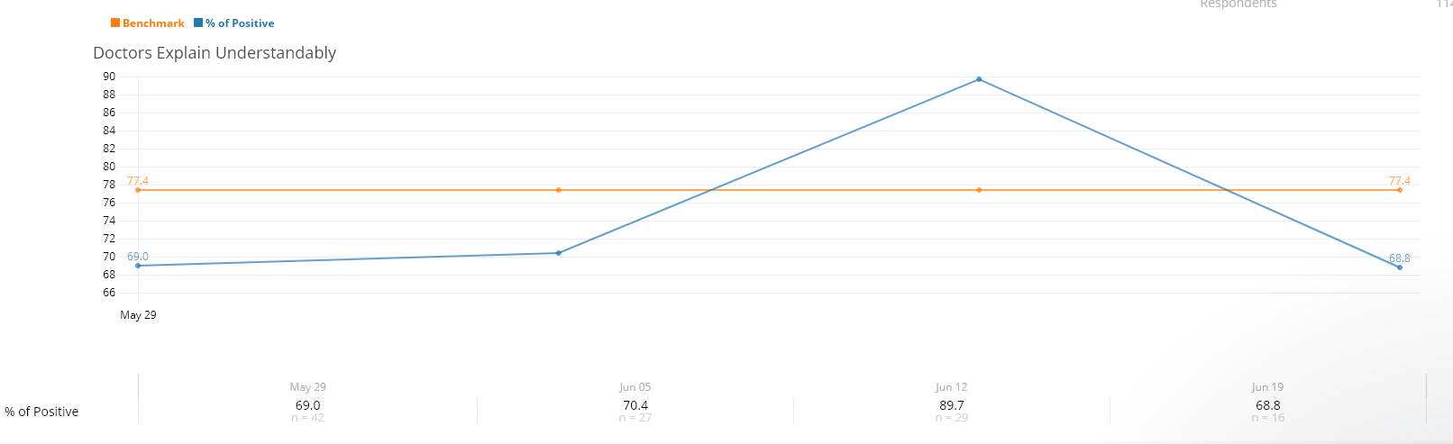
Care Experience

Slide 68
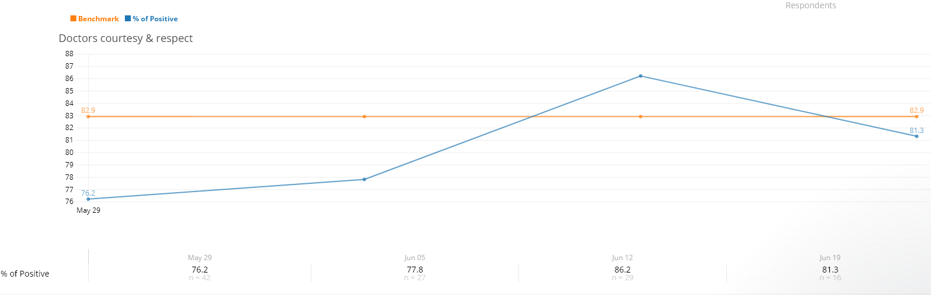
Care Experience

Slide 69
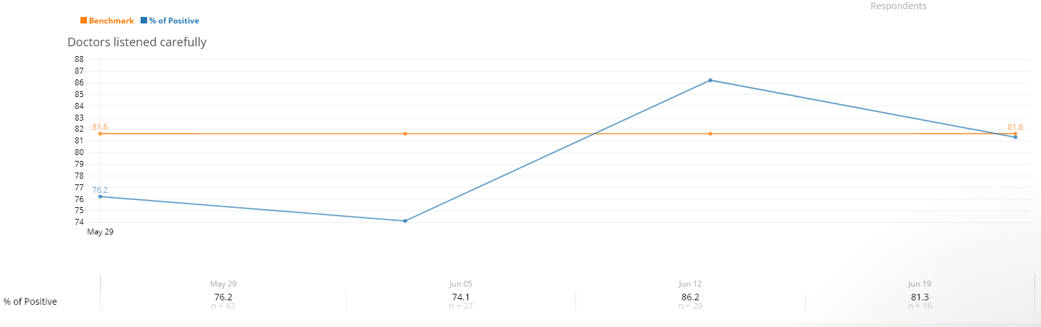
Care Experience

Slide 70
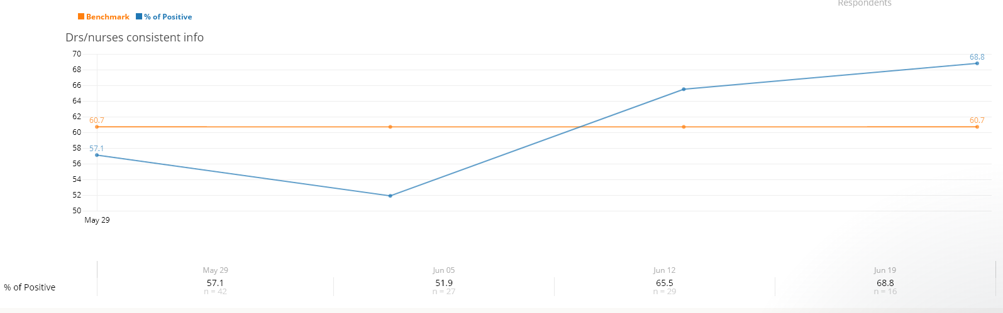
Care Experience

Slide 71
Recommendations
Keep up the good work
Ask about medication side effect question during MDR- Do you have any questions about your meds or their side effects?

Slide 72

Meeting adjourned @ 7:00p Thanks
Please sign your timesheets ☺
  -Sean

